Slide 1
Patient Engagement and Quality by Design: Co-Developing an Implementation Roadmap for Clinical Trials

Slide 2
What is the Patient Engagement Open Forum
A series of virtual events (in 2020) where we will work together, in a multi-stakeholder context, to turn patient engagement into reality.
The Forum aims to provide a holistic perspective of patient engagement, the landscape and actors, and foster collaboration and co-creation while breaking down fragmentation that are often present in patient engagement work.

Slide 3
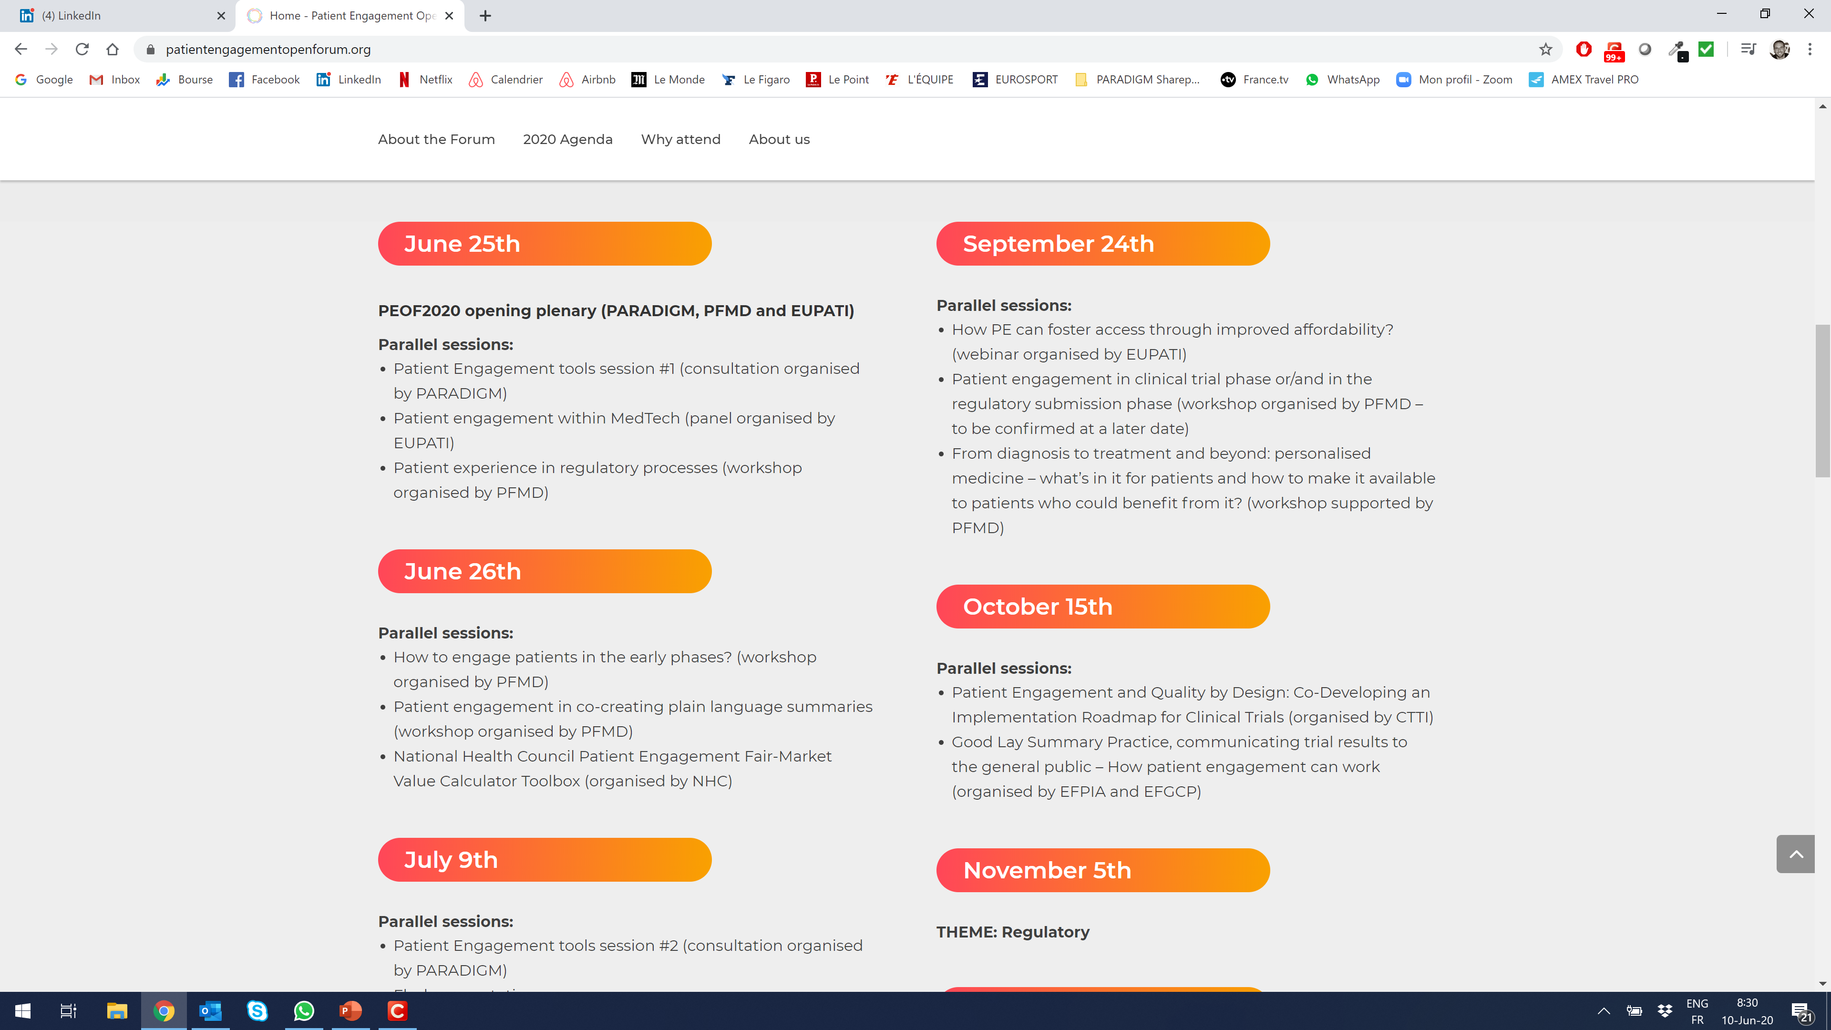
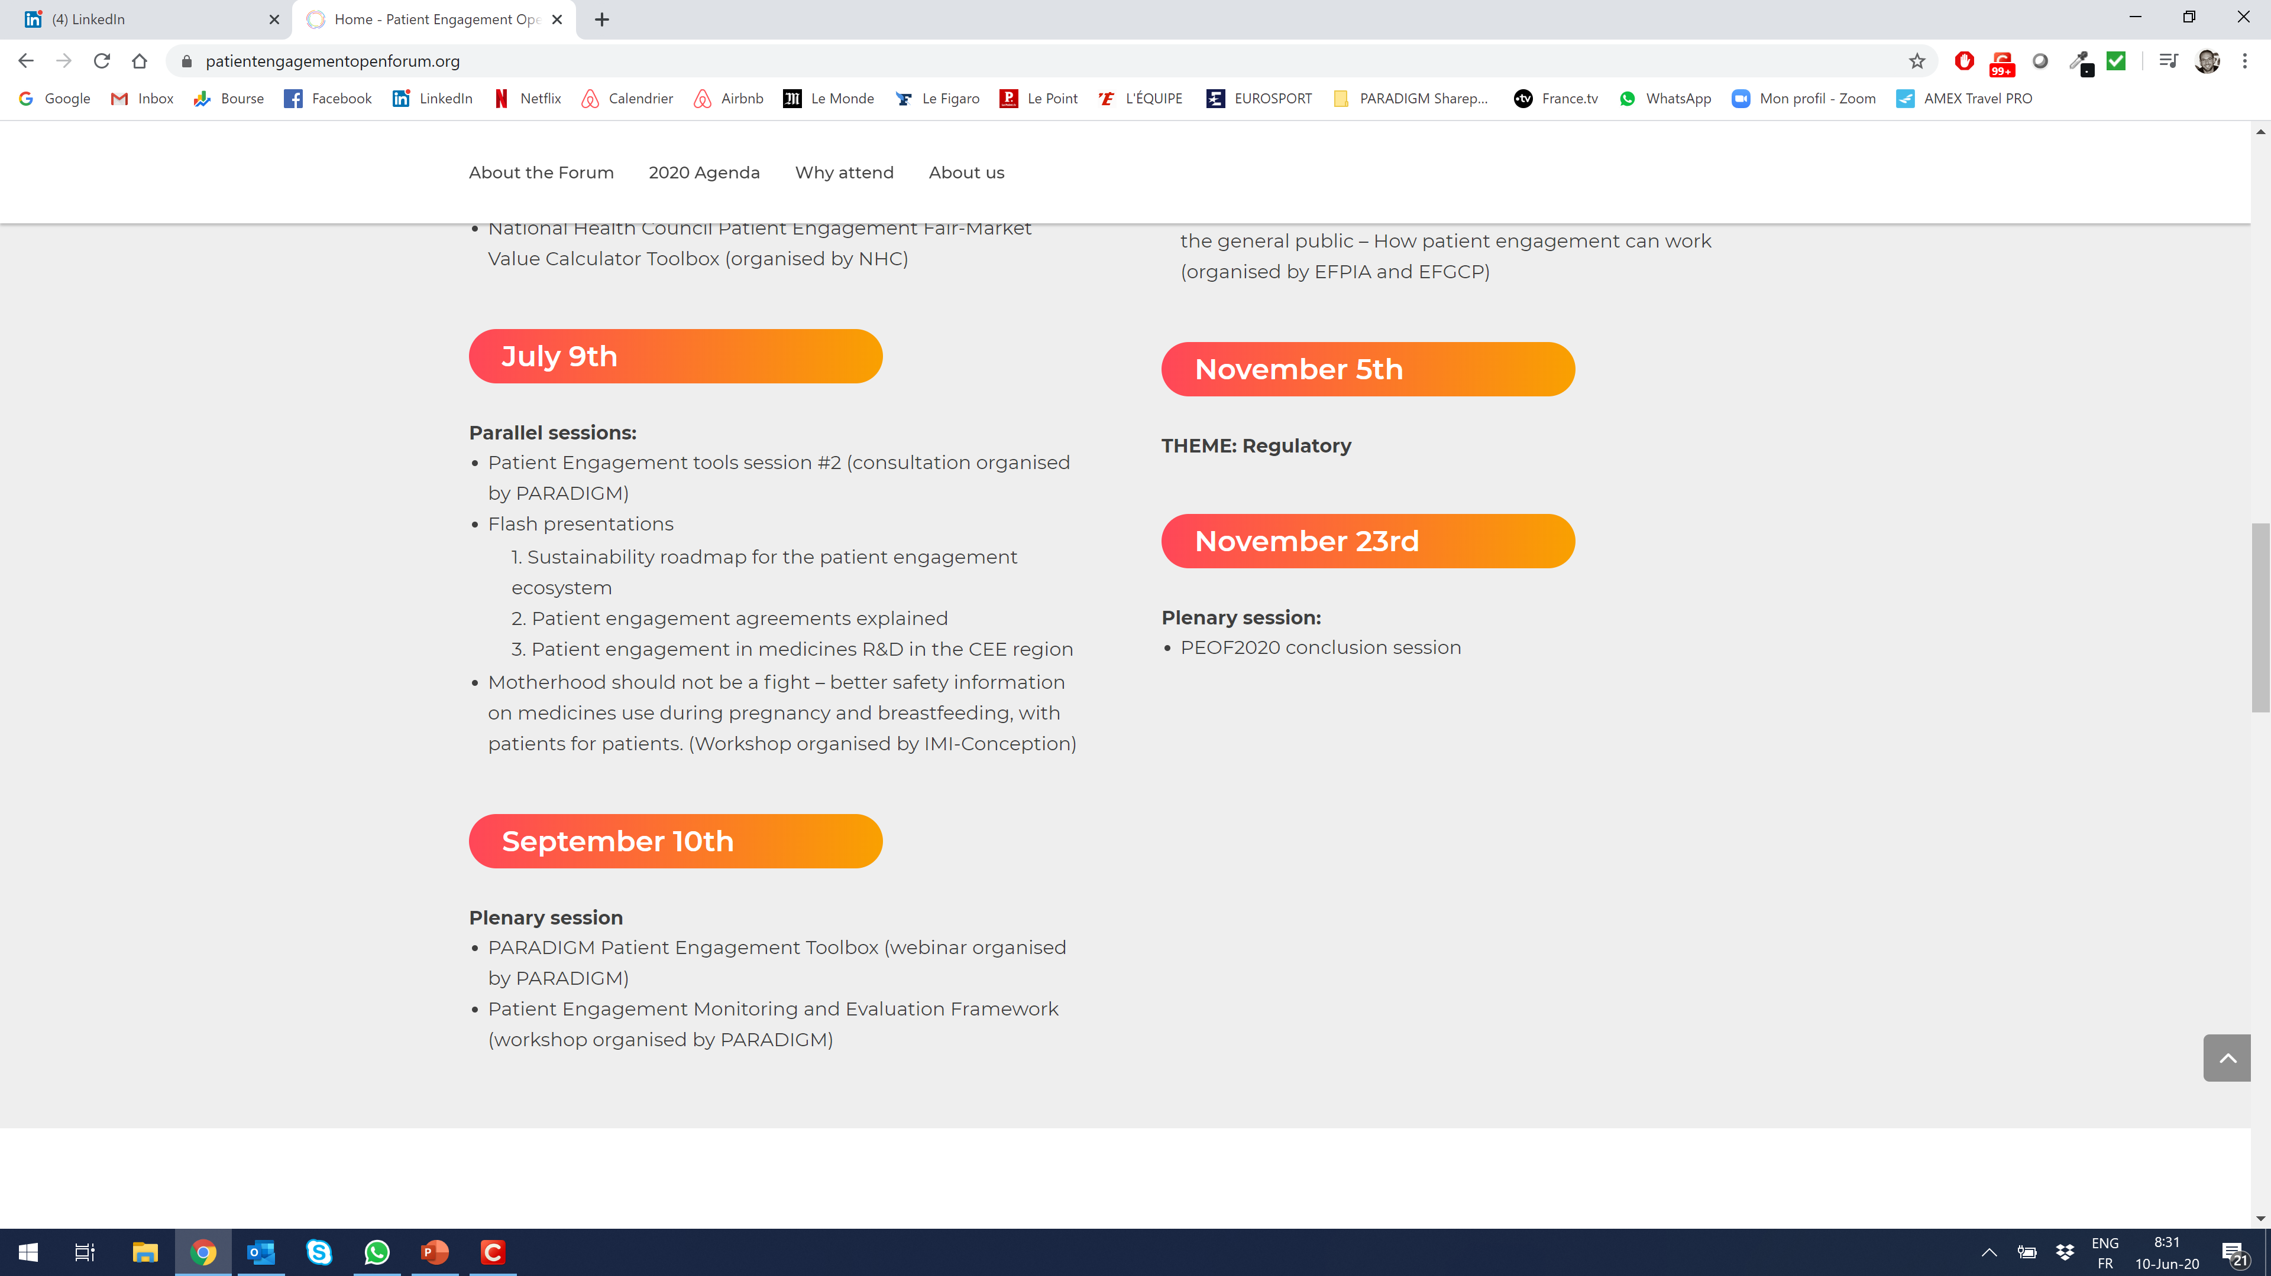
Agenda

Slide 4
Let’s work together to spread the word
#PEOF2020
@imi-paradigm
@eupatients
@PFMDwithPatient

Slide 5
Patient Engagement and Quality by Design: Co-Developing an Implementation Roadmap for Clinical Trials
15 October 2020

Slide 6
Disclaimer
The views and opinions expressed in this presentation are those of the individual presenter and do not necessarily reflect the views of the Clinical Trials Transformation Initiative or of the institutions with which presenters are individually affiliated.

Slide 7

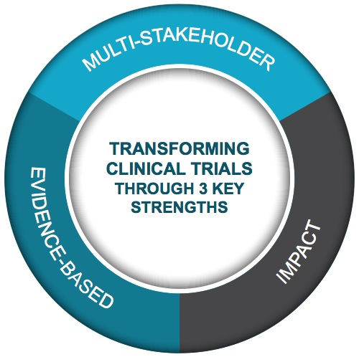
Multi-stakeholder,
public-private partnership
co-founded by Duke University & FDA
Participation of 500+ more orgs and + 80 member organizations
MISSION: To develop and drive adoption of practices that will increase the quality and efficiency of clinical trials

Slide 8
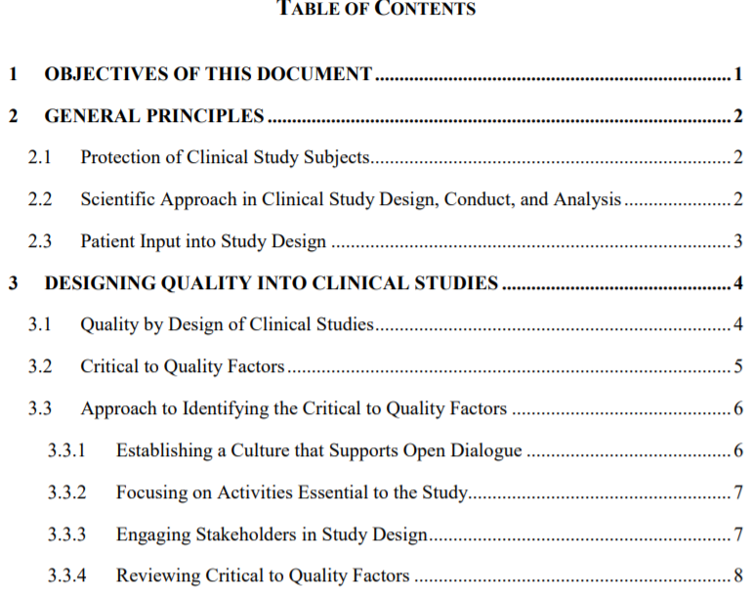
Context: Ongoing “GCP Renovation” May Incorporate QbD Concepts into ICH E8
ICH E8(R1) Draft Principles
Protection of clinical study participants is a shared responsibility (investigators, sponsors, IRB/IECs).
Clinical studies should be designed, conducted, and analyzed according to sound scientific principles and reported appropriately.
Consulting with patients and/or patient organizations in the design, planning and conduct of clinical studies helps to ensure that all perspectives are captured.
https://database.ich.org/sites/default/files/E8-R1_EWG_Draft_Guideline.pdf

Slide 9
Today’s Objectives
Discuss the role of patient engagement in a Quality by Design (QbD) approach to study planning
Identify opportunities for patient input at key decision points in clinical trial design
Support sponsor and patient group stakeholders in articulating the broader value proposition of QbD and patient engagement
Agenda:
Welcome and Introduction (10 min)
Quality by Design: Key Concepts (10 min)
Case Studies (25 min)
Aligning QbD and Patient Engagement (25 min)
Discussion and Q&A (20 min)

Slide 10

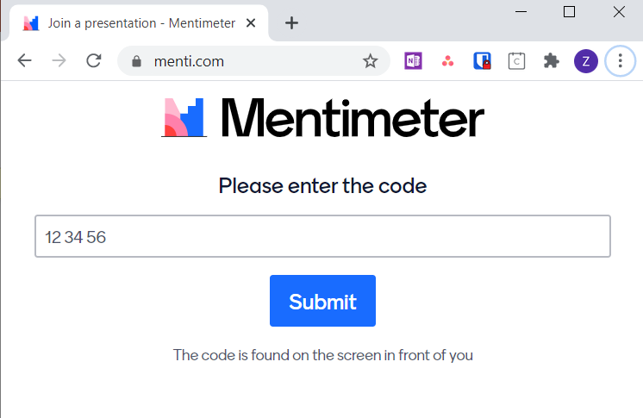
Please Share Your Knowledge With Us
Session is Recorded
Chat Box for detailed comments and questions to panelists
Click “chat” button at bottom of Zoom window to open
Polling questions throughout
Please go to www.menti.com now
Enter code 40 84 66 8
Or look in the chat box for a direct link

Slide 11





Brief Introductions
Attendees: Please say hello in the chat box!
Jaye Bea Smalley
Immunovant
Kerstin Koenig
ICH E8 Working Group Member
Karlin Schroeder
Parkinson’s Foundation
Rick Bangs
Cancer Research Advocate

Slide 12
Please respond in Mentimeter
How familiar are you with the principles of Quality by Design for clinical trials?
Very familiar
Somewhat familiar
Not very familiar
Not at all familiar

Slide 13
Quality by Design: Key Concepts
Kerstin Koenig, ICH E8 Working Group Member

Slide 14

“
You start out with a
beautiful green tree that should be admired, and then everybody in the family wants to put an ornament on it... and no one will take grandma’s ornament off the tree. So you end up with a protocol that is impossible to do and is very distracted from answering the question you originally had.”
- Dr. Robert Califf, Mind the Gap seminar, “Innovative Approaches to Clinical Trials”

Slide 15
Evolution of Quality
CTTI Quality Projects: 2008 to Present
Monitoring
Key Insights:
Quality cannot be ‘monitored in’
A “quality by design” approach is needed (direct parallel to manufacturing)
Quality by Design
Key Outputs:
Multi-Stakeholder recommendations
QbD Toolkit to help apply principles
QbD Adoption
Addressing Gaps:
Expanded Toolkit
Concrete examples
Organization-level planning and implementation tools
Reframing “quality” as the absence of errors
that matter to decision making.

Slide 16




CTTI Quality by Design Recommendations
Create a culture that:
Values and rewards critical thinking and open dialogue about quality
Goes beyond sole reliance on tools and checklists
Involve the broad range of stakeholders in protocol development and discussions around study quality
Prospectively identify and periodically review the critical to quality factors
Focus effort on activities that are essential to the credibility of the study outcomes

Slide 17
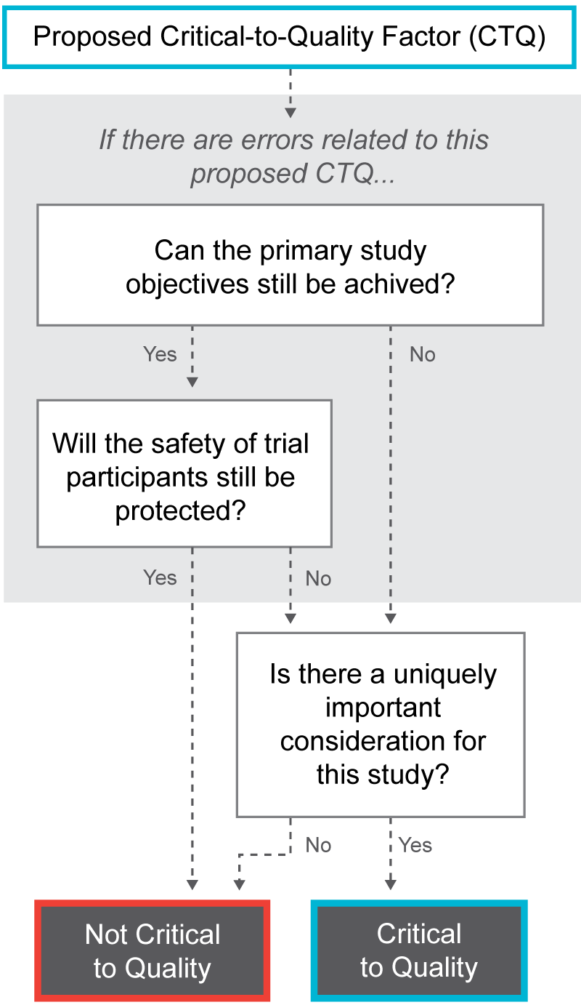
Any Element of the Study Can be “Critical to Quality”
Topic | Examples of Potential CTQ Factors
Protocol Design | Eligibility Criteria
 | Randomization
 | Masking
 | Types of Controls
 | Data Quantity
 | Endpoints
 | Procedures Supporting Study Endpoints and Data Integrity
 | IP Handling and Administration
Feasibility | Study and Site Feasibility
 | Accrual
Patient Safety | Informed Consent
 | Withdrawal Criteria and Trial Participant Retention
 | Signal Detection and Safety Reporting
 | Data Monitoring Committee /Stopping Rules
Study Conduct | Training
 | Data Recording and Reporting
 | Data Monitoring and Management
 | Statistical Analysis
Study Reporting | Dissemination of Study Results
Third-Party Engagement | Delegation of Sponsor Responsibilities
 | Collaborations

Slide 18
Operationalizing the Critical to Quality Factors
High retention critical for primary efficacy analysis
4-6 hour site visits may increase
dropout rates
Remove assessments if not tied to primary or key secondary endpoint
Minimize site visits; use digital health technologies and tele-visits
Sites not near patients; may lead to high dropout rates
Provide travel/logistics support for necessary site visits
Critical to Quality Factors (CTQs)
(Via Trial Design and/or Oversight)
Specific Risks to CTQ
(Via Trial Design and/or Oversight)
Strategies to Address Risks
(Via Trial Design and/or Oversight)
Example

Slide 19
QbD Approach to Study Design
Engage all stakeholders to…
Identify critical to quality aspects of trial design and potential challenges
Tailor design to avoid errors that could undermine evaluability or safety
Streamline trial where feasible
Verify proposed design consistent with scientific question
Highlight and evaluate residual risks
Operationally feasible trial design
Efficient, focused trial oversight plans (e.g., monitoring, data management)

Slide 20
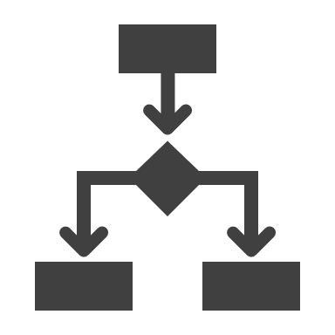









Outcome of Quality by Design
INTELLIGENT DESIGN
TAILORED IMPLEMENTATION
Optimal design to allow intended question(s) to be reliably addressed
Oversight informed by knowledge of important risks not addressed through trial design
Leverages insights from patients and other trial stakeholders to validate that the question and endpoints are meaningful
Monitoring focused on important risks to trial credibility, data integrity, and participant safety
Clearly defined and rational number of endpoints, accepted by relevant stakeholders, and measured at appropriate timepoints.
Leverages centralized and statistical monitoring where feasible
Clearly defined population with sufficient numbers of participants for statistical validity
Adapts oversight based on insights gained during trial conduct
Procedures conducted and data collected are directly relevant to trial endpoints (efficacy and safety)
Accounts for variation in medical practice across intended sites

Slide 21
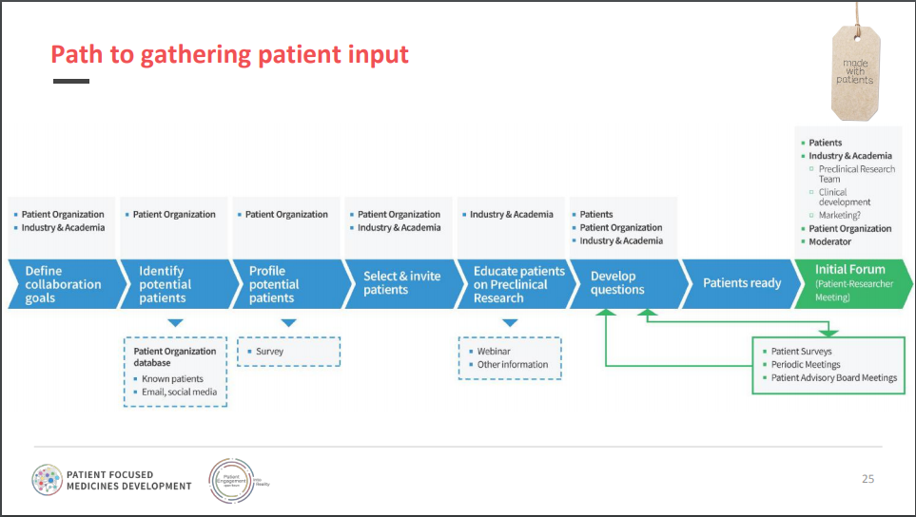
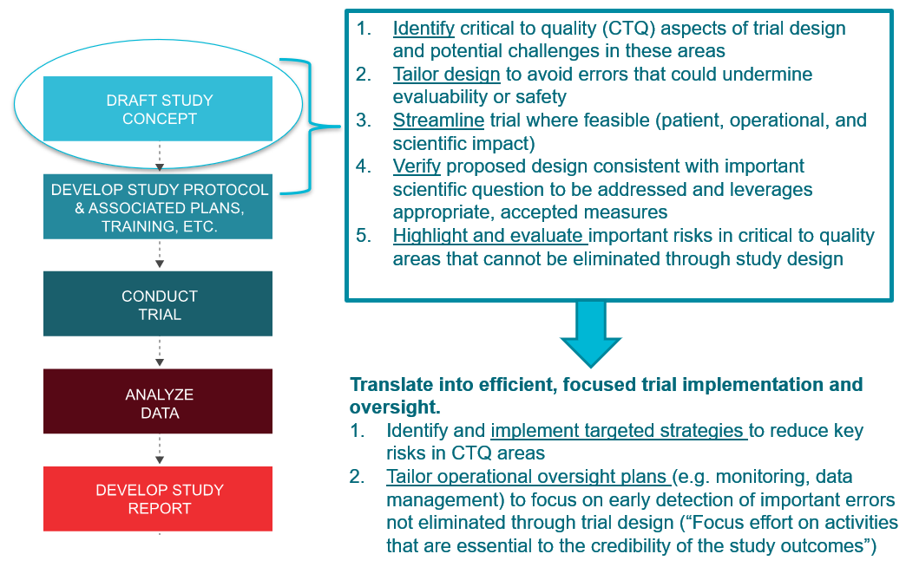
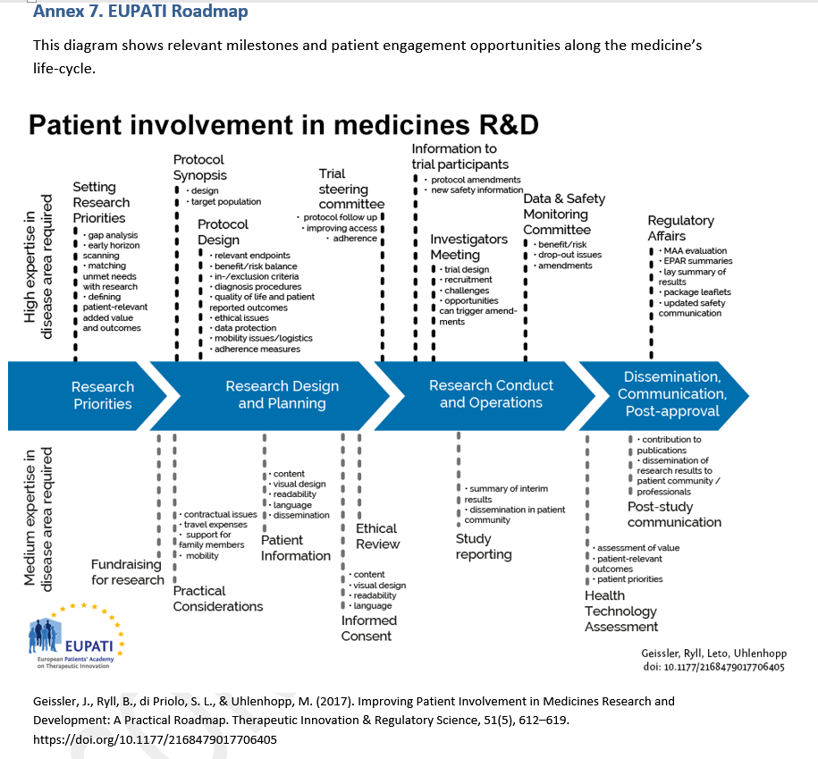
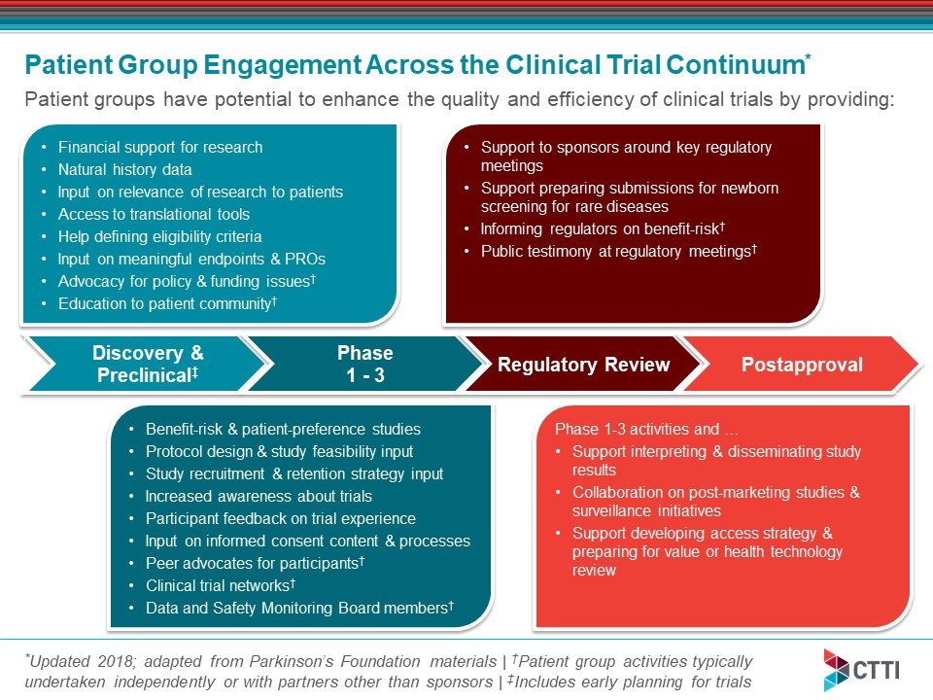
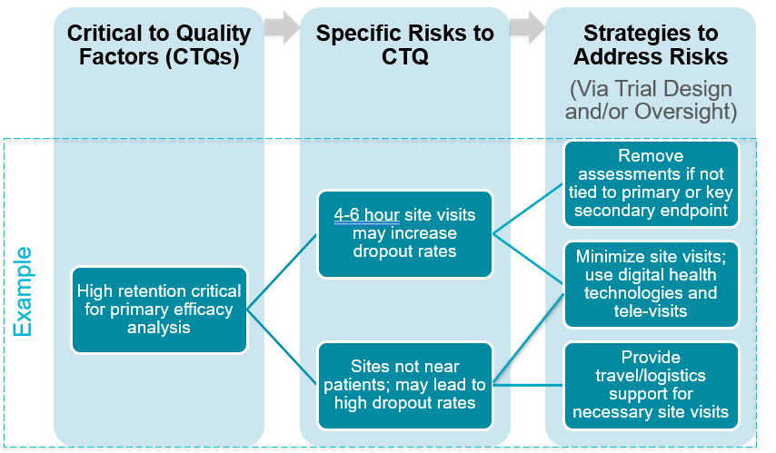
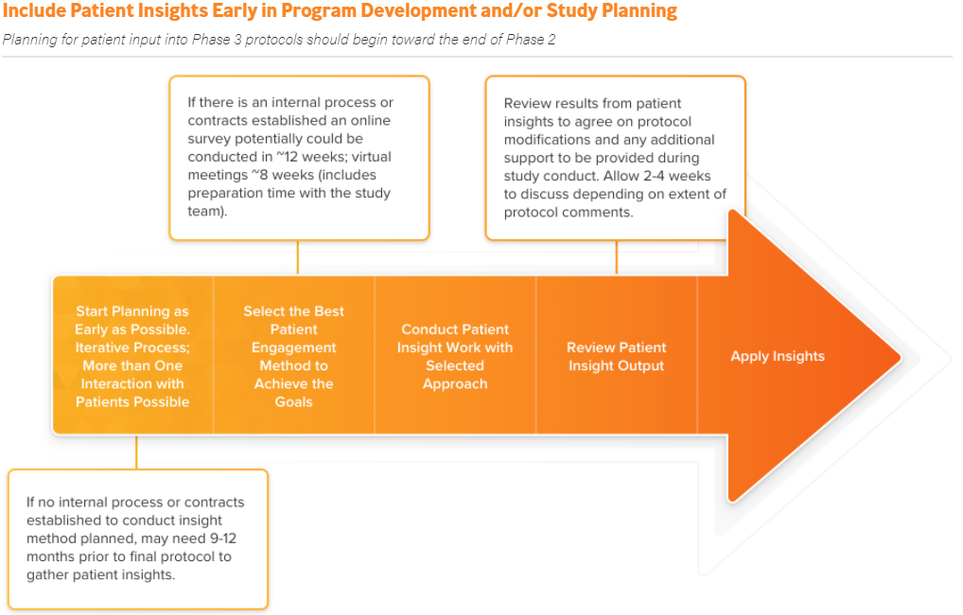
Key Question: How do we align patient engagement and QbD approaches to study design?
Patient Engagement
Quality by Design

Slide 22
Please respond in Mentimeter
How clear is the intersection between patient engagement and QbD?
Very clear
Somewhat clear
Not very clear
Not at all clear
I’m not sure yet
Why did you give your answer? Please tell us more in the chat box.

Slide 23
Aligning Patient Engagement and QbD: Case Studies
Karlin Schroeder, Parkinson’s Foundation
Jaye Bea Smalley, Immunovant
Rick Bangs, Cancer Research Advocate

Slide 24
Case Study 1:
Improving a Phase II Drug Trial

Slide 25
Parkinson’s Foundation Case Study
Patient Engagement Perspective
2016
How can we make this study meet community needs and priorities?
How can we reduce study burden so all stakeholders get to our shared goal: better therapies on the market more quickly?
QbD Perspective
2020
Critical to quality factors
  Endpoints
  Study Feasibility
Critical to quality factors
  Accrual
  Retention

Slide 26




Methods and Outcomes
Patient Advisory Board
Patient Engagement at Clinical Operations Meetings
Impact
  3 changes directly to study protocol
  5 other recommendations adapted to improve study
Outcomes
  Faster study recruitment and better retention

Slide 27
Basis for Success in Patient Engagement in QbD
Critical to quality factors for patient community and research team naturally aligned (ex: reduced study burden benefits everyone)
Partners were fully dedicated to patient engagement
Patient engagement occurred in a standard way around aspects of the research process that are low hanging fruit.

Slide 28
Gaps/Challenges/What’s Next?
Patient engagement can often be the overlooked component of QbD. How do we support embedding it as an integral part of the process?
Existing tools and resources to support QbD in patient engagement are underutilized. How do we increase uptake and fill the gaps?
How can we use QbD to drive more advanced models of patient engagement and pilot new ways of working together?

Slide 29
Case Study 2:
Patient Engagement in Drug Development
Content is the opinion of Jaye Bea Smalley, not Immunovant

Slide 30
Sponsors May Be Well Positioned to Enhance QbD Due to Evolving Patient Engagement Capabilities
Drivers of patient engagement in clinical development:
Changing expectations on the part of patient advocacy partners to be engaged in clinical development plans, design of clinical trials, and recruitment strategies
Greater awareness on the part of project teams on the potential for patients to address issues of burden or feasibility for patient participation
Advisory board methodology in place; policies and processes that can easily be adapted to accommodate patients, carers and advocates
Emerging role of patient engagement professionals embedded with in companies

Slide 31
Examples of Patient Engagement Enhancing QbD
Factor | Considerations in Evaluating CTQ Factor | Example Input from Patient Community | Actions After Consulting Patient Community
Feasibility | Describe the countries and regions in which the trial is planned. Consider both the countries/regions in which the trial will initially be conducted and those that might be added to bolster enrollment. If the trial could not be conducted in these regions, would there be an impact on the trial completion or conclusions? | After reviewing the feasibility of a trial for Batten’s disease, the patient organization pointed out that it would be unfair to only deploy the trial at US sites. | A third site was added in Europe and the patient organization helped to identify potential sites within an established research network that would be feasible with the protocol requirements
Informed Consent | What are the key elements of the informed consent process for this study? Have various stakeholders, especially patients and treating physicians, been involved in the development of the informed consent document? | A diverse group of previous clinical trial participants identifies the need for more tools to consult the consent process | The company develops a video on consent and identifies several programs that will benefit from the video guides to support the informed consent process

Slide 32
Gaps and Challenges Still Exist for Sponsors to Adopt a Comprehensive Approach to Patient Engagement in Qbd
How do you take a more systematic approach to addressing critical quality factors through patient engagement?
Can QbD framework for patient input help further define the diverse informational needs of project teams?
The advisory board method can be time consuming and expensive. What other methods can be leveraged to gain patient input with the aim of enhancing QbD?
Who are the organizational champions for patient engagement?
Expand the value proposition of incorporating the patient perspective in QbD

Slide 33
Case Study 3:
Patient Advocate Engagement:
Lessons Learned from the SWOG and National Cancer Institute Patient Advocate Committees
Content is the opinion of Rick Bangs, not SWOG or NCI

Slide 34
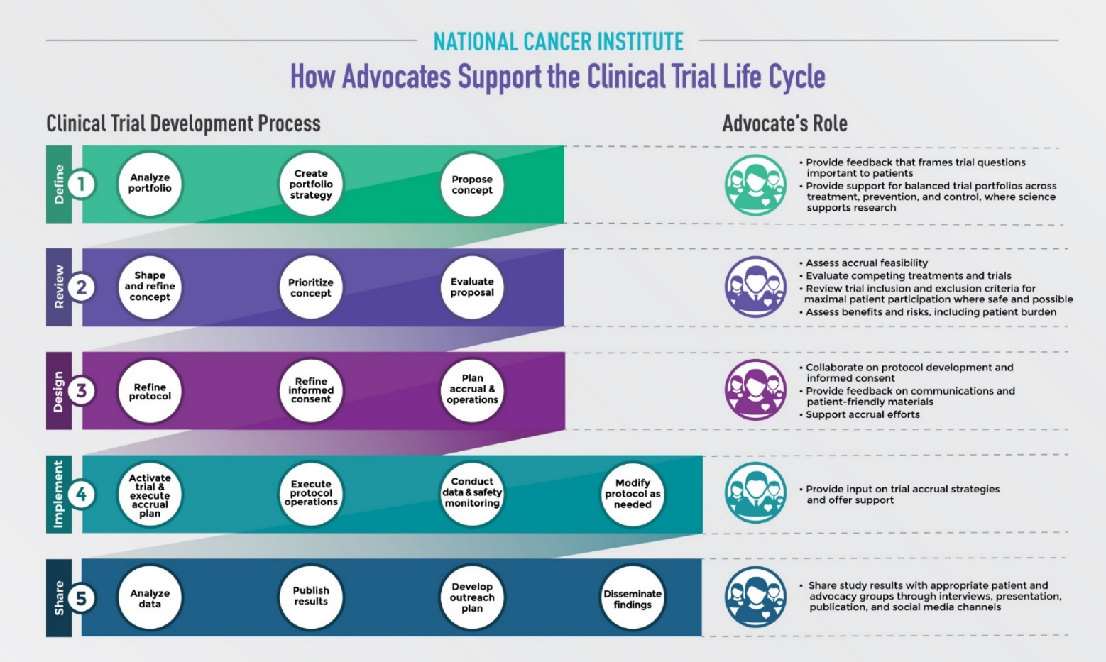
Define and Train “Methodology” (Activities)
https://www.pcori.org/research-results/2017/framework-patient-engagement-cancer-network-group-studies

Slide 35



Define Success
Researcher-Advocate Engagement Goal
SWOG Researcher
I embed my Patient Advocate throughout my research process as a Trusted Partner.
SWOG Advocate
I am embedded into the research process and proactively provide significant insight to my Committee.
I feel safe in offering my opinion, my opinions are valued, and I take accountability for my area of focus.
I do not engage my Patient Advocate.
I do not reach across the aisle to my research partners – I merely wait and take orders.

Slide 36
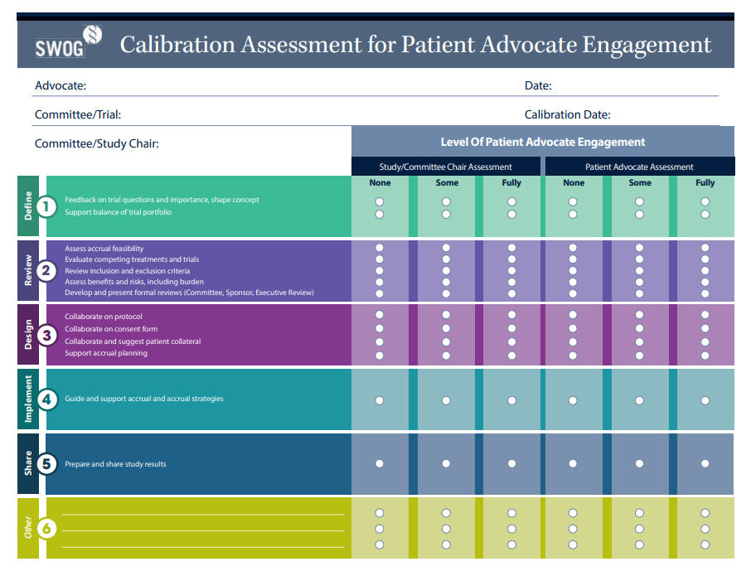
Calibrate and Clarify Roles / Measure Success

Slide 37

Prepare Templates and Accelerators
7. Patient Advocacy Evaluation Questions
  7.1 How important is this trial to people who have been or will be diagnosed with this disease?
  7.2 What aspects of this trial design might attract patients or be of concern to patients?
  7.3 How well does this trial balance the risk, benefits, and burdens of the patient and/or the caregiver?
  7.4 What effect will the eligibility/inclusion and exclusion criteria have on the target patient population?
  7.5 Is this study likely to be able to meet accrual goals and retain patients through completion?
  7.6 Are there other patient-related issues that should be considered?

Slide 38
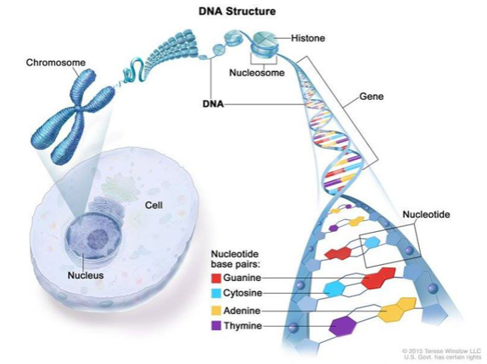



Define and Train Competencies* (Skills and Knowledge)
Cancer & Research Competencies
Role Competencies
Process Competencies
(How work gets done)
Effective Engagement Competencies
*Competencies can range from familiarity to expertise.

Slide 39

Patient Advocate Input – QbD (Strawman)
Possible Core Activities (CTQ; many are iterative)
Study Population
Inclusions/Exclusions
Diversity and Representativeness
Endpoints
Patient Reported Outcomes
Accrual Forecasts, Plans, and Feasibility
Retention
Data Safety and Monitoring Boards
Consent Form
Etc.

Slide 40
Please respond in Mentimeter
After hearing the case studies: Have you already been doing patient engagement work that can enhance QbD?
Yes, almost definitely
Maybe, but I’m not sure
No, probably not
Why did you give your answer? Please tell us more in the chat box.

Slide 41
Any questions about the case studies?
Please submit questions and comments in the chat box!

Slide 42
Aligning QbD and Patient Engagement

Slide 43
“How often is patient input typically sought on each of the clinical trial design elements below?” (Your responses)
Topic | Examples of Potential CTQ Factors
Protocol Design | Eligibility Criteria
 | Randomization
 | Masking
 | Types of Controls
 | Data Quantity
 | Endpoints
 | Procedures Supporting Study Endpoints & Data Integrity
 | IP Handling & Administration
Feasibility | Study & Site Feasibility
 | Accrual
Patient Safety | Informed Consent
 | Withdrawal Criteria & Trial Participant Retention
 | Signal Detection & Safety Reporting
 | Data Monitoring Committee /Stopping Rules
Study Conduct | Training
 | Data Recording & Reporting
 | Data Monitoring & Management
 | Statistical Analysis
Study Reporting | Dissemination of Study Results
Third-Party Engagement | Delegation of Sponsor Responsibilities
 | Collaborations

Slide 44
Please respond in Mentimeter
Let’s confirm…
In your experience, how often is patient input sought on protocol design elements such as eligibility criteria, randomization, masking, and types of controls?
Rarely
Sometimes
Often
Why did you give your answer? Please tell us more in the chat box.

Slide 45
Please respond in Mentimeter
What are the major barriers to getting patient input on all aspects of study design?
(Open ended question. Please take a moment to type your response in Mentimeter.)
Why did you give your answer? Please tell us more in the chat box.

Slide 46
Methods for Obtaining Patient Input on Study Design Include…
‘At The Table’
Study- or program-level
Participating on research teams, review teams, and steering committees
Patient Meetings
1:1 or in groups, virtually or in-person, one-time or recurring
Large-Scale Sampling
Surveys/questionnaires by sponsor, CRO, patient group
Online portals and registries
Interviews, focus groups, design studios, patient advisory boards, protocol simulations
‘Social listening’ and social media

Slide 47
Please respond in Mentimeter
How can we get patients ‘at the table’ with the sponsor, CRO and other stakeholders early in study design?
(Open ended question. Please take a moment to type your response in Mentimeter.)
Why did you give your answer? Please tell us more in the chat box.

Slide 48
Strawman Proposal:
Aligning QbD & Patient Engagement
Draft Study Concept
Draft Protocol
Final Protocol
IDENTIFY
CTQs / risks / mitigations
REFINE
CTQs / risks / mitigations
Who: Patient ‘experts’
How: At the table
What: Discuss all aspects of study design to identify critical-to-quality factors, potential risks & mitigation strategies
Who: Broad range of patients
How: Patient meetings & large-scale sampling (e.g., surveys)
What: Confirm & refine CTQs, risks & mitigation strategies
What works? What doesn’t? Please tell us in the chat box.

Slide 49
Discussion and Q&A
Please submit your questions and comments in the chat box!

Slide 50
Please respond in Mentimeter
How can researchers and research sponsors start integrating QbD and patient engagement? Please suggest one ‘next step’.
(Open ended question. Please take a moment to type your response in Mentimeter.)
Why did you give your answer? Please tell us more in the chat box.

Slide 51
Please respond in Mentimeter
How can patients and patient organizations start integrating QbD and patient engagement? Please suggest one ‘next step’.
(Open ended question. Please take a moment to type your response in Mentimeter.)
Why did you give your answer? Please tell us more in the chat box.

